Slide 1
Ulitmate Tic Tac Toe Search Strategies
An Artificial Intelligence Study on the game of Ultimate Tic Tac Toe

Slide 2
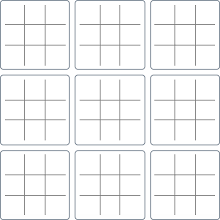
Ultimate Tic Tac Toe

Slide 3
Ultimate Tic Tac Toe

Slide 4
Ultimate Tic Tac Toe

Slide 5
Game Statistics
It takes at least 17 moves for player 1 to win, and 18 for player 2
Most games take between 40 and 60 moves
No game can take more than 81 moves
There are 2.860 * 10³⁸ different games states possible.
Information on Ultimate Tic Tac Toe’s model

Slide 6
Minimax Search
Current Board State
-1053
75
Minimax trees show what the best move is to a certain depth. The tree looks n moves ahead and selects moves based off of which player’s turn it is.
O wins
10000
-1053
O Ties
0
75

Slide 7
Board Evaluation
Winning a local board: W₁
Two global cells out of three in a row, column, or diagonal: W₂
Two local cells out of three in a row, column, or diagonal: W₃

Slide 8
Title and content layout with chart

